Slide 1
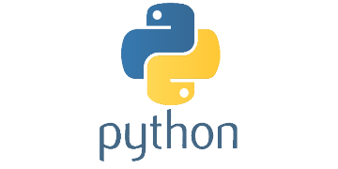
INTRODUCTION TO PYTHON

Slide 2

OVERVIEW
Background
What is Python
History
Features
Python Syntax
Variable Types

Slide 3

What is Python...?
Python is a general purpose programming language that is often applied in scripting roles.
So, Python is programming language as well as scripting language.
Python is also called as Interpreted language.

Slide 4
Differences between program and scripting language
Program | Scripting
A program is executed (i.e. the source is first compiled, and the result of that compilation is expected). | A script is interpreted.
A "program" in general, is a sequence of instructions written so that a computer can perform certain task. | A "script" is code written in a scripting language. A scripting language is nothing but a type of programming language in which we can write code to control another software application.

Slide 5

History
Invented in the Netherlands, early 90s by Guido van Rossum
Python was conceived in the late 1980s and its implementation was started in December 1989
Guido Van Rossum is fan of ‘Monty Python’s Flying Circus’, this is a famous TV show in Netherlands
Named after Monty Python
Open sourced from the beginning.

Slide 6

Features
Python is object-oriented
Indentation
It's free (open source)
It's powerful
It's portable
It's mixable
It's easy to use
It's easy to learn

Slide 7

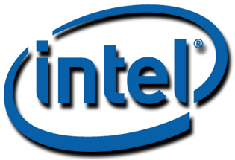

Who Uses Python
Python is being applied in real revenue-generating products by real companies. For instance:
Google makes extensive use of Python in its web search system, and employs Python’s creator.
Intel, Cisco, Hewlett-Packard, Seagate, Qualcomm, and IBM use Python for hardware testing.
ESRI uses Python as an end-user customization tool for its popular GIS mapping products.
The YouTube video sharing service is largely written in Python.

Slide 8
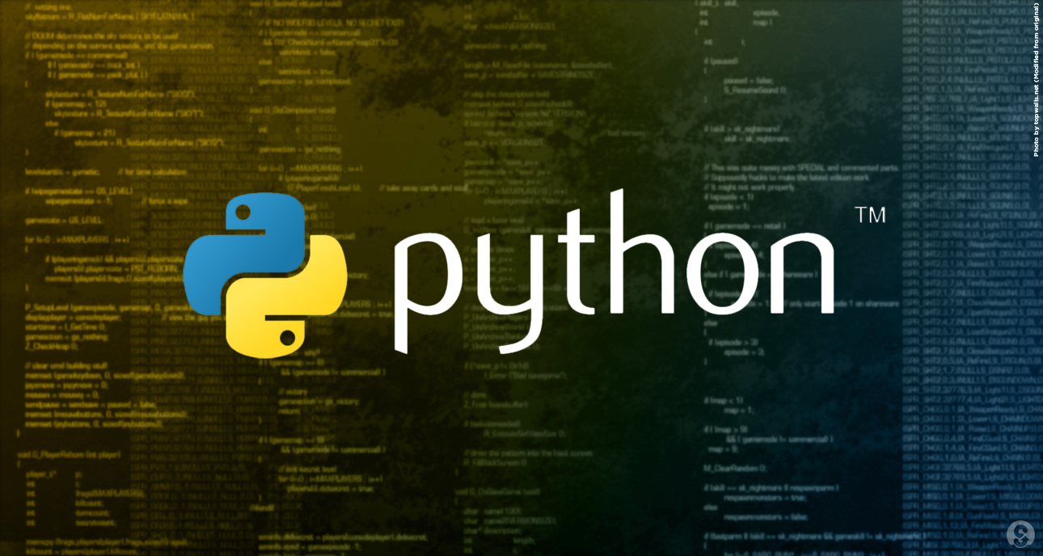
Syntax

Slide 9
A Sample Code
x = 34 - 23 # A comment.
y = “Hello” # Another one.
z = 3.45
if z == 3.45 or y == “Hello”:
x = x + 1
y = y + “ World” # String concat.
print x
print y

Slide 10
Enough to understand the code
Indentation matters to code meaning
- Block structure indicated by indentation
First assignment to a variable creates it
- Variable types don’t need to be declared.
- Python figures out the variable types on its own.
Assignment is = and comparison is ==
For numbers + - * / % are as expected
- Special use of + for string concatenation and % for string formatting (as in C’s printf)
Logical operators are words (and, or, not) not symbols
The basic printing command is print

Slide 11
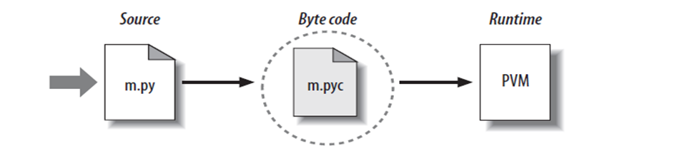
Python Code Execution
Python’s traditional runtime execution model: source code you type is translated to byte code, which is then run by the Python Virtual Machine. Your code is automatically compiled, but then it is interpreted.
Source code extension is .py
Byte code extension is .pyc (compiled python code)

Slide 12
Running Python
Once you're inside the Python interpreter, type in commands at will.
Examples:
>>> print 'Hello world'
Hello world
# Relevant output is displayed on subsequent lines without the >>> symbol
>>> x = [0,1,2]
# Quantities stored in memory are not displayed by default
>>> x
# If a quantity is stored in memory, typing its name will display it
[0,1,2]
>>> 2+3
5

Slide 13




Python Variable Types
Variables are nothing but reserved memory locations to store values. This means that when you create a variable you reserve some space in memory.
Based on the data type of a variable, the interpreter allocates memory and decides what can be stored in the reserved memory. Therefore, by assigning different data types to variables, you can store integers, decimals or characters in these variables.

Slide 14
Assigning Values to Variables
Python variables do not need explicit declaration to reserve memory space. The declaration happens automatically when you assign a value to a variable. The equal sign (=) is used to assign values to variables.
The operand to the left of the = operator is the name of the variable and the operand to the right of the = operator is the value stored in the variable. For example −
#!/usr/bin/python counter = 100 # An integer assignment miles = 1000.0 # A floating point name = "John" # A string print counter print miles print name
Here, 100, 1000.0 and "John" are the values assigned to counter, miles, and name variables, respectively. This produces the following result −
100 1000.0 John

Slide 15
Multiple Assignment
Python allows you to assign a single value to several variables simultaneously. For example −
a = b = c = 1
Here, an integer object is created with the value 1, and all three variables are assigned to the same memory location. You can also assign multiple objects to multiple variables. For example −
a, b, c = 1, 2, "john"
Here, two integer objects with values 1 and 2 are assigned to variables a and b respectively, and one string object with the value "john" is assigned to the variable c.

Slide 16
Standard Data Types
The data stored in memory can be of many types. For example, a person's age is stored as a numeric value and his or her address is stored as alphanumeric characters. Python has various standard data types that are used to define the operations possible on them and the storage method for each of them.
Python has five standard data types −
Numbers
String
List
Tuple
Dictionary

Slide 17
Python Numbers
Number data types store numeric values. Number objects are created when you assign a value to them. For example −
var1 = 1 var2 = 10
You can also delete the reference to a number object by using the del statement. The syntax of the del statement is −
del var1[,var2[,var3[....,varN]]]]
You can delete a single object or multiple objects by using the del statement. For example −
del var del var_a, var_b
Python supports four different numerical types −
int (signed integers)
long (long integers, they can also be represented in octal and hexadecimal)
float (floating point real values)
complex (complex numbers)

Slide 18
Python Strings
Strings in Python are identified as a contiguous set of characters represented in the quotation marks.
The plus (+) sign is the string concatenation operator and the asterisk (*) is the repetition operator. For example −
#!/usr/bin/python str = 'Hello World!' print str # Prints complete string print str[0] # Prints first character of the string print str[2:5] # Prints characters starting from 3rd to 5th print str[2:] # Prints string starting from 3rd character print str * 2 # Prints string two times print str + "TEST" # Prints concatenated string
This will produce the following result −
Hello World! H llo llo World! Hello World!Hello World! Hello World!TEST

Slide 19
Python Lists
Lists are the most versatile of Python's compound data types.For example −
#!/usr/bin/python list = [ 'abcd', 786 , 2.23, 'john', 70.2 ] tinylist = [123, 'john'] print list # Prints complete list print list[0] # Prints first element of the list print list[1:3] # Prints elements starting from 2nd till 3rd print list[2:] # Prints elements starting from 3rd element print tinylist * 2 # Prints list two times print list + tinylist # Prints concatenated lists
This produce the following result −
['abcd', 786, 2.23, 'john', 70.200000000000003] abcd [786, 2.23] [2.23, 'john', 70.200000000000003] [123, 'john', 123, 'john'] ['abcd', 786, 2.23, 'john', 70.200000000000003, 123, 'john']

